Slide 1
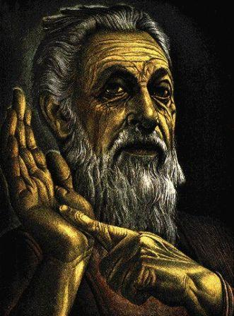
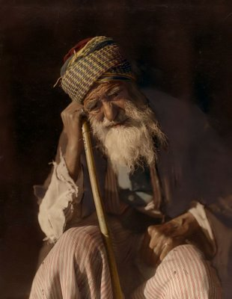
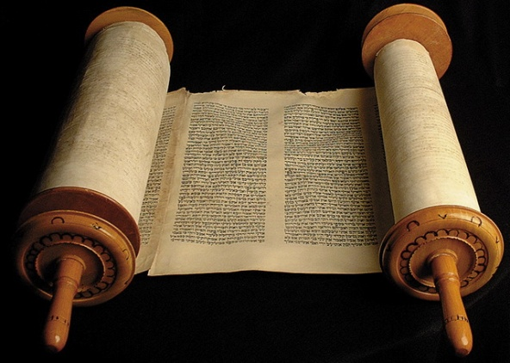
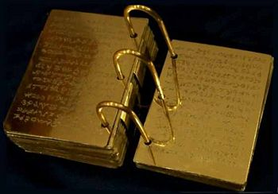
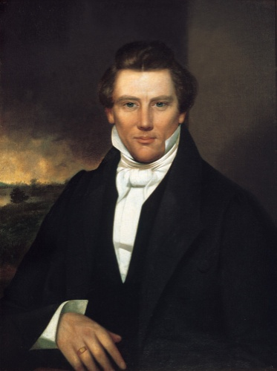
Latter Day Prophecy Fulfilled
By
Seventy James L. Noland

Slide 2
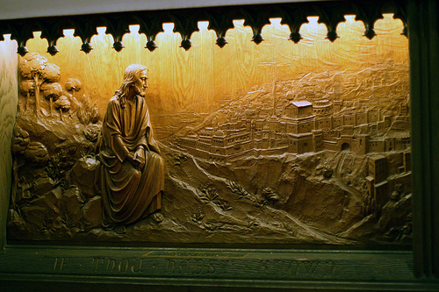
And Jesus went out, and departed from the temple; and his disciples came to him for to hear him, saying, Master, show us concerning the buildings of the temple; as thou hast said; They shall be thrown down and left unto you desolate.
And Jesus said unto them, See ye not all these things? And do ye not understand them? Verily I say unto you, There shall not be left here upon this temple, one stone upon another, that shall not be thrown down. And Jesus left them and went upon the mount of Olives. [Matthew 24:1-3]

Slide 3
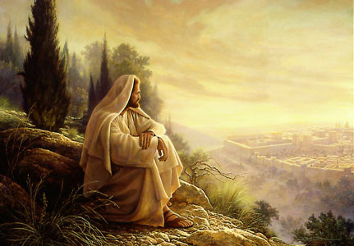
And as he sat upon the mount of Olives, the disciples came unto him privately, saying, Tell us, when shall these things be which thou hast said concerning the destruction of the temple, and the Jews; and what is the sign of thy coming; and of the end of the world? (or the destruction of the wicked, which is the end of the world.)
[Matthew 24:4]

Slide 4
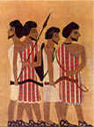
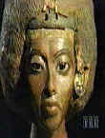
EZEKIEL 37
THE VALLEY OF DRY BONES
.
THE SPIRITUAL DEATH AND RESURRECTION OF
THE ISRAELITE NATION

Slide 5
All things which have befallen them, are only the beginning of the sorrows which shall come upon them; and except, those days should be shortened, there should none of their flesh be saved.
But for the elect's sake, according to the covenant, those days shall be shortened.
Behold these things I have spoken unto you concerning the Jews. [Matthew 24:19-21]

Slide 6


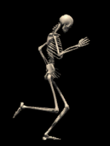




Slide 7
The toe bone connected to the heel bone.
The heel bone connected to the foot bone.
The Foot bone connected to the ankle bone.
It’s easy to connect those dry bones.

Slide 8
The foot bone connected to the leg bone.
The leg bone connected to the knee bone.
The knee bone connected to the thigh bone.
It’s easy to connect those dry bones.

Slide 9

The finger bone connected to the hand bone.
The hand bone connected to the wrist bone.
The wrist bone connected to the arm bone.
It’s easy to connect those dry bones.

Slide 10
The arm bone connected to the shoulder bone.
The shoulder bone connected to the collar bone.
The collar bone connected to the neck bone.
It’s easy to connect those dry bones.

Slide 11
Well, the neck bone connected to the chin bone.
The chin bone connected to the nose bone.
The nose bone connected to the head bone.
It’s easy to connect those dry bones.

Slide 12
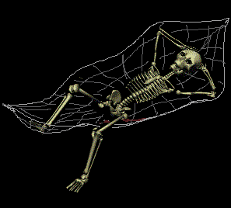

Slide 14
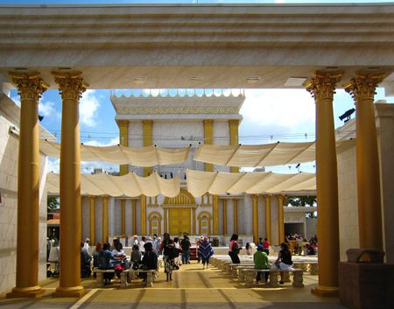
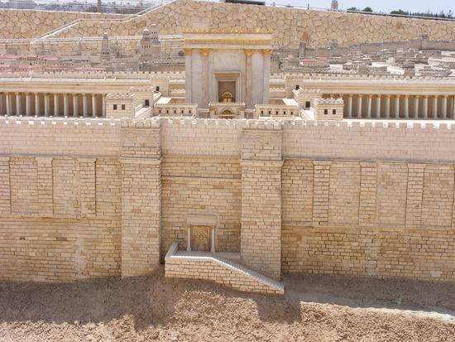

During the last days of his life, Jesus had assembled his disciples together on the Mt. of Olives overlooking the Temple. The disciples were uncertain and anxious about the future especially in light of Jesus' cleansing of the Temple and stopping the sacrifices, and his astonishing statements delivered in holy anger denouncing the Pharisees.
The disciples opened the conversation by talking about the beauty of the temple and its courts. Jesus opened his amazing and detailed reply by predicting the soon-coming destruction of that magnificent building:

Slide 15
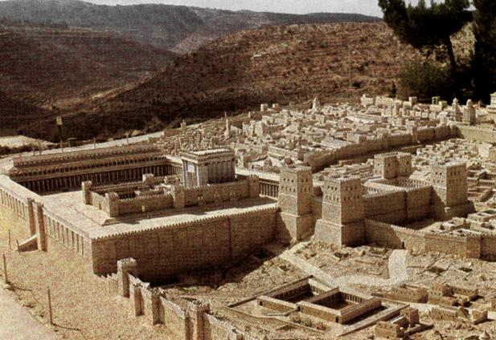
Jesus left the temple and was going away, when his disciples came to point out to him the buildings of the temple. But he answered them, "You see all these, do you not? Truly, I say to you, there will not be left here one stone upon another, that will not be thrown down." As he sat on the Mount of Olives, the disciples came to him privately, saying, "Tell us, when will this be, and what will be the sign of your coming and of the close of the age?" (Matthew 24:1-3)

Slide 16
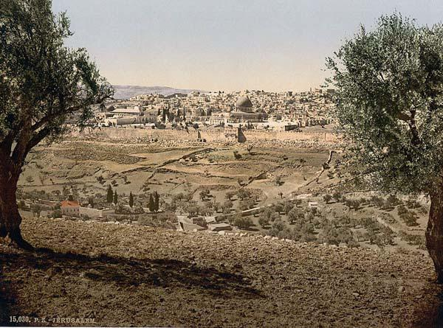
Both the Temple and the City of Jerusalem were indeed about to be destroyed. With four Legions, Titus the Roman General, later to become Caesar, began the siege of Jerusalem in April, A.D. 70. He posted his 10th legion on the Mount of Olives, directly east of and overlooking the Temple Mount. The 12th and 15th legions were stationed on Mount Scopus, further to the east and commanding all ways to Jerusalem from east to north. The 5th legion was held in reserve.

Slide 17
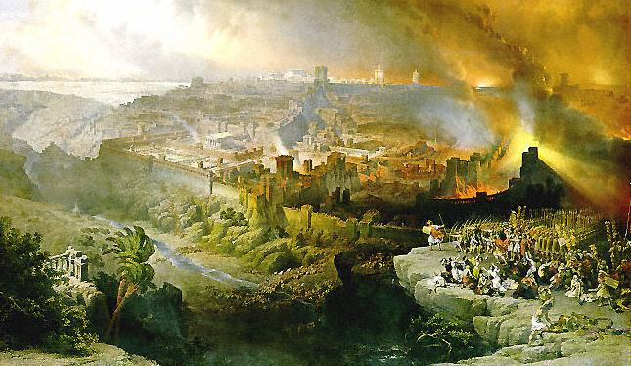
On the 10th of August, in A.D. 70, the very day when the King of Babylon burned the Temple in 586 B.C., the Temple was burned again. Titus took the city and put it to the torch, burning the Temple.

Slide 18
Jewish historian, Flavius Josephus was present in Jerusalem when the city was captured and the Temple was burnt. He described the event in this manner:
The Romans, thought it was a terrible struggle to collect the timber, raised their platforms in twenty-one days, having as described before stripped the whole area in a circle round the town to a distance of ten miles. The countryside like the City was a pitiful sight; for where once there had been a lovely vista of woods and parks there was nothing but desert and stumps of trees. No one - not even a foreigner - who had seen the Old Judea and the glorious suburbs of the City, and now set eyes on her present desolation, could have helped sighing and groaning at so terrible a change; for every trace of beauty had been blotted out by war, and nobody who had known it in the past and came upon it suddenly would have recognized the place: when he was already there he would still have been looking for the City.
Josephus speaks of the house to house fighting that occurred:

Slide 19
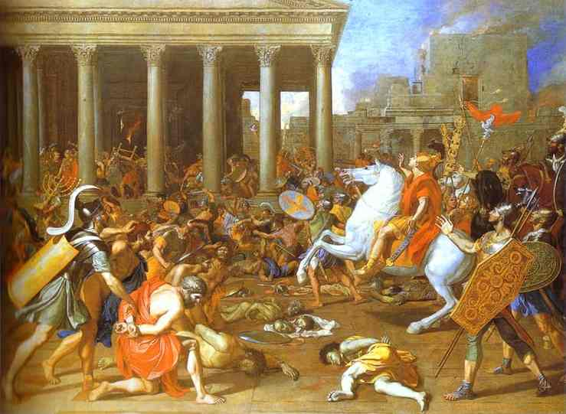

Slide 20
These Romans put the Jews to flight, and proceeded as far as the holy house itself. At which time one of the soldiers, without staying for any orders, and without any concern or dread upon him at so great an undertaking, and being hurried on by a certain divine fury, snatched somewhat out of the materials that were on fire, and being lifted up by another soldier, he set fire to a golden window, through which there was a passage to the rooms that were round about the holy house, on the north side of it.
As the flames went upward, the Jews made a great clamor, such as so mighty an affliction required, and ran together to prevent it; and now they spared not their lives any longer, nor suffered anything to restrain their force, since that holy house was perishing . . . thus it was the holy house burnt down . . . Nor can one imagine anything greater or more terrible than this noise; for there was at once a shout of the Roman Legions, who were marching all together, and a sad clamor of the seditious, who were now surrounded with fire and sword . . . the people under a great consternation, made sad moans at the calamity they were under . . . Yet was the misery itself more terrible than this disorder; for one would have thought that the hill itself, on which the Temple stood, was seething hot, as full of fire on every part of it.

Slide 21
And Josephus lists the horrendous outcome:
To give a detailed account of their outrageous conduct is impossible, but we may sum it up by saying that no other city has ever endured such horrors, and no generation in history has fathered such wickedness. In the end they brought the whole Hebrew race into contempt in order to make their own impiety seem less outrageous in foreign eyes, and confessed the painful truth that they were slaves, the dregs of humanity, bastards, and outcasts of their nation.
It is certain that when from the upper city they watched the Temple burning they did not turn a hair, though many Romans were moved to tears.
The prediction of Jesus with regard to the city and the Temple were now fulfilled:
As the flames shot into the air the Jews sent up a cry that matched the calamity and dashed to the rescue, with no thought now of saving their lives or husbanding their strength; for that which hitherto they had guarded so devotedly was disappearing before their eyes.
Jerusalem was totally destroyed and as Jesus had predicted - not one stone was left upon another. When the Temple was set on fire the Roman soldiers tore apart the stone to get the melted gold. The Menorah and vessels were carried to Rome and the treasury was robbed.

Slide 22
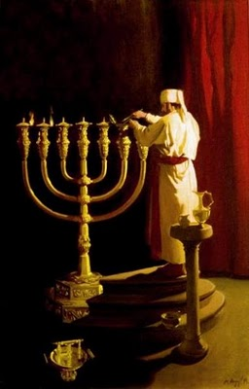
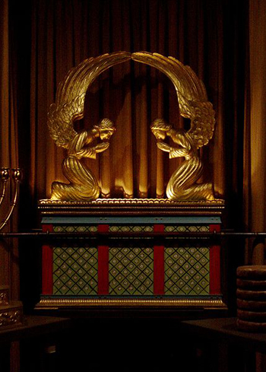
As Daniel had predicted the Temple was destroyed after the Messiah had come, not before.

Slide 23
Bible scholar Ray C. Stedman comments on the predictions of Jesus and their fulfillment in history a few years later,
In Luke 21:19 we have other details of this predicted overthrow of the city and the Temple. There Jesus adds,
" And when ye shall see Jerusalem compassed with armies, then know that the desolation thereof is nigh.."
Forty years later the Roman armies under Titus came in and fulfilled the prediction to the very letter.
With Titus was a Jewish historian named Josephus who recorded the terrible story in minute detail. It was one of the most ghastly sieges in all history.

Slide 24
When the Romans came the city was divided among three warring factions of Jews who were so at each others' throats that they paid no heed to the approach of the Romans. Thus Titus came up and surrounded the city while it was distracted by its own internecine warfare. The Romans assaulted the walls again and again, and gave every opportunity to the Jews to surrender and save their capital from destruction.
During the long siege a terrible famine raged in the city and the bodies of the inhabitants were literally stacked like cordwood in the streets. Mothers ate their children to preserve their own strength. The toll of Jewish suffering was horrible but they would not surrender the city.

Slide 25
Again and again they attempted to trick the Romans through guile and perfidy. When at last the walls were breached Titus tried to preserve the Temple by giving orders to his soldiers not to destroy or burn it. But the anger of the soldiers against the Jews was so intense that, maddened by the resistance they encountered, they disobeyed the order of their general and set fire to the Temple.
There were great quantities of gold and silver there which had been placed in the Temple for safekeeping. This melted and ran down between the rocks and into the cracks of the stones. When the soldiers captured the Temple area, in their greed to obtain this gold and silver they took long bars and pried apart the massive stones. Thus, quite literally, not one stone was left standing upon another. The Temple itself was totally destroyed, though the wall supporting the area upon which the Temple was built was left partially intact and a portion of it remains to this day, called the Western Wall.

Slide 26
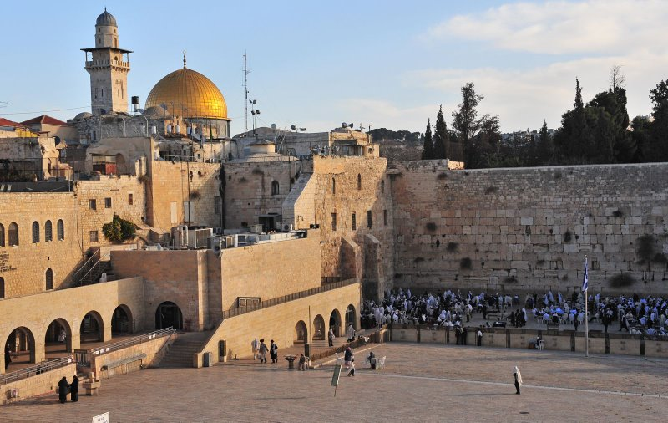

Slide 27
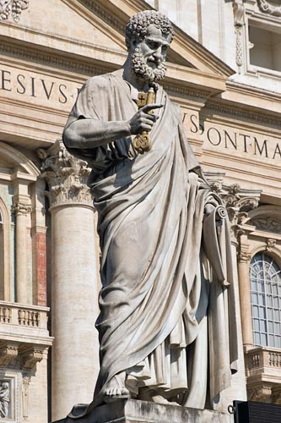
A Temple Legend
Flavius Josephus also recorded a legend that sprung up about the Temple. While the Temple was on fire and there was tremendous looting, killing and rape many rushed to the Temple to die rather than become Roman slaves. When the flames leaped through the roof and the smoke had risen in thick columns one of the priests supposedly climbed to the top of the main tower. He had in his hand the key to the sanctuary.
When he reached the top he cried out, "If you, Lord, no longer judge us to be worthy to administer Your house, take back the key until You deem us worthy again." As the legend goes, a hand appeared from heaven and took the key from the priest.

Slide 28
A Second Exile for Israel
When the Temple was destroyed in A.D. 70 the period of the second exile began. The Jewish people were soon to be scattered throughout the earth.
Then said Jesus unto them, All ye shall be offended because of me this night; for it is written, I will smite the Shepherd, and the sheep of the flock shall be scattered abroad. [Matthew 26:28]
For the next 1900 years the Jews would have no authority in the land God gave to Abraham, Isaac, and Jacob. However during most of the period of this Second Exile there have always been some Jews living in Jerusalem. Although most of the nation was in exile from their land, the Jews did not forget Jerusalem or the Temple Mount. Their daily prayer was for the rebuilding of the Temple in Jerusalem. The traditional Jewish prayer book contains the following passage:

Slide 29
Because of our sins we were exiled from our country and banished from our land. We cannot go up as pilgrims to worship Thee, to perform our duties in Thy chosen house, the great and Holy Temple which was called by Thy name, on account of the hand that was let loose on Thy sanctuary. May it be Thy will, Lord our God and God of our fathers, merciful King, in Thy abundant love again to have mercy on us and on Thy sanctuary; rebuild it speedily and magnify its glory.
For the next two thousand years, the Temple Mount would lack any Jewish presence.
The destruction of the Temple in A.D. 70 caused the beginning of the scattering of the Jews throughout the world. During this period, the Temple Mount was for the most part neglected and profaned. Though this time constituted a period of neglect some significant events concerning Jerusalem and the Temple Mount did occur.

Slide 30
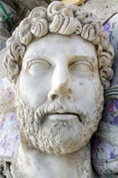
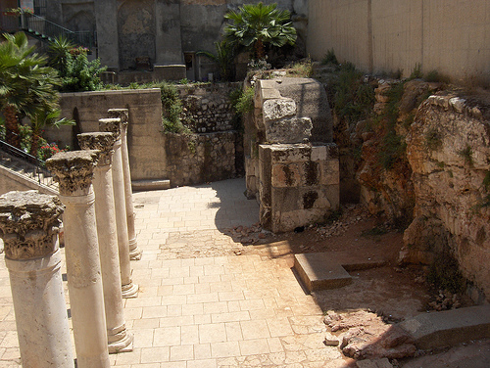
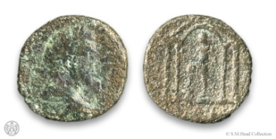
Hadrian
In the first hundred years after the city and Temple were destroyed, there was high expectation among the Jews that they would once again return to their land and rebuild that which was devastated. The Court of 70 Elders, the Sanhedrin, was intact and many Jews still lived in small communities in Israel. Their hopes were dashed by the Emperor Hadrian when he decided to establish a new city on the ruins of Jerusalem. The Old City was plowed up to make way for the new Roman city to be named Colonia Aelia Capitolina.

Slide 31
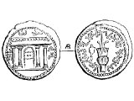
Second Jewish Revolt
Hadrian's actions, particularly his attempted to eradicate all traces of a Jewish city named Jerusalem, caused ongoing rebellion among the Jews. In response, there were large scale mass murders of Jews in Caesarea and other communities by the Romans. These murders sparked a larger rebellion led by a man named Simon Bar Kochba (A.D. 132-135). Bar Kochba rallied the people and massacred the famous 12th legion of the Roman army. Jerusalem was liberated for three years and Rabbi Akiva proclaimed Bar Kochba as the Messiah who was to deliver the Jewish people.
The Jews proceeded to set up an independent government. Coins were struck that commemorated the "First Year of the Deliverance of Israel." One coin showed the facade of the Temple. It is possible that Bar Kochba attempted to rebuild the Temple.

Slide 32
One later historical work (Chronicon Paschale) describes Hadrian as the one who destroyed the Temple of the Jews. The Roman historian Dio Cassius also said that Hadrian built his Temple to replace the one of the God of Israel. Some, therefore, assume that the Chronicon is not referring to the destruction of the original Temple by Titus in A.D. 70 but to a later destruction by Hadrian of a partially restored Temple built by Bar Kochba.
Within three years of Jerusalem's liberation under the Bar Kochba revolt, Rome marched against the rebels and killed Bar Kochba. The Sanhedrin officially labeled him a false Messiah and Jerusalem was again in Roman hands. Jewish Jerusalem was once again blotted out and Aelia Capitolina was built on its site as had been planned. Because the war had cost the lives of Roman heroes, the Jews were thenceforth forbidden to enter Jerusalem upon penalty of death. Hadrian attempted to destroy every connection Jerusalem had with the Jewish people. Christians of Jewish background were also excluded from the city, but gentile Christians were able to remain.

Slide 33
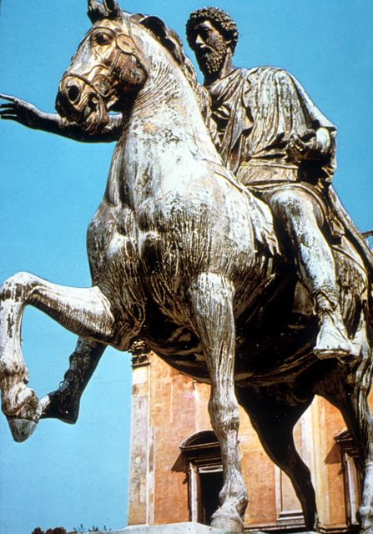
In an effort to leave no trace of the Second Temple, Hadrian erected a Temple to Jupiter Capitolinus on the site. An equestrian statue of Hadrian was also built on the site.
The next Emperor, Antonius Pius (A.D. 138-161), added another statue. The Jews were only allowed to enter the city on special occasions to mourn on the Temple Mount.

Slide 34
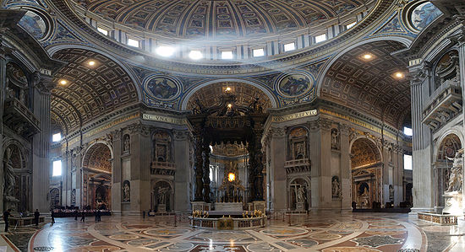
Constantine and the "Christian" Roman Empire
In A.D. 324 Emperor Constantine and his mother Queen Helena were converted to Christianity. Aelia Capitolina was renamed Jerusalem and the title of "Holy City" was restored to her. It was now, however, considered the Holy City of Christianity, not the national capital of the Jews. The pagan temple Hadrian was destroyed and the church of Holy Zion was built on the Temple Mount. These conditions lasted under A.D. 362 when the Roman emperor Julian the Apostate permitted the Jews to return.

Slide 35
Then sudden tragedy struck. The foundations of the Second Temple were barely uncovered when flames of fire burst forth from under the ground. The flames were accompanied by large explosions. The cause for the flames were probably the result of noxious gas in the subterranean passages catching fire. The workmen fled and the building was stopped, never again to be restarted. Many believed that the explosion and fire were a demonstration of the anger of God.
With their hopes dashed, the Jews were then driven into Exile and became wanderers in foreign lands. They were people without a homeland. For some eighteen centuries they would be dispersed and persecuted. Throughout time their thoughts were of the Temple which once stood in Jerusalem and prayers for its restoration.

Slide 36
A Plan to Rebuild
There was one occasion after the destruction of the Second Temple when the Jews were able to formulate plans to rebuild their temple. The man behind this project was the Roman Emperor, Flavius Claudius Julianus, a nephew of Constantine - also known as Julian the Apostate because of his opposition to Christianity.
Julian planned the project in the last year of his reign in A.D. 363. Julian rescinded all the anti-Jewish laws that his uncle Constantine had instituted. He issued an edict that the Temple be rebuilt in Jerusalem. This caused a great deal of excitement among the Jews. From far and wide, Jews came to Jerusalem to help in the rebuilding work. Julian supplied the necessary funds and appointed Alypius of Antioch, the Roman Governor of Great Britain, to carry out the project. Jews from all over gave from their wealth upon the projected work of rebuilding the Temple. The roads to Jerusalem were filled with multitudes of Jewish men and women who had hopes of seeing a Third Temple built.

Slide 37
Visible Remains of the Temple
From ancient records we can glean some information about visible remains of the Temple after its destruction. Eusebius, bishop of Caesarea (A.D. 260-340) testified that he could still see the remains of the sanctuary. He said that the large stone blocks were hauled away to build sanctuaries and theaters. During this period of exile the city was visited by a pilgrim known as the traveler of Bordeaux. He gave the following testimony in A.D. 333:
At the side of the Sanctuary, there is a pierced stone. Jews visit there once a year, pour oil over it, lament and weep over it, and tear their garments in token of mourning. Then they return home.
The once-a-year visit was probably on the Jewish date of the destruction of both Temples. The pierced stone, or a rock with a hollow in it, is not identified. It is assumed by some to have been the foundation stone upon which the Holy of Holies was built. In the Talmud we find a reference to the "Foundation Rock" which the Holy of Holies had rested (Yoma 5:2).

Slide 38
Early church father John Chrysostom wrote:
The Jews began uncovering the foundations by removing masses of earth, intending to go ahead and build ...You can see the bared foundations if you visit Jerusalem now...Some of its parts (sanctuary) are razed to the ground.
The Jews were allowed to enter the city only one day a year during this period of exile. In A.D. 392 the Christian leader Jerome wrote concerning this day:
On the anniversary of the day when the city fell and was destroyed by the Romans, there are crowds who mourn, old women and old men dressed in tatters and rags, and from the Top of the Mount of Olives this throng laments over the destruction of its Sanctuary. Still their eyes flow with tears, still their hands tremble and their hair is disheveled, but already the guards demand pay for their right to weep.
In the sixth century the Pilgrim of Piacenze mentions the ruins of the Temple of Solomon. From these accounts we can deduce that there were at least some visible remains of the Temple foundation through the sixth century.

Slide 39
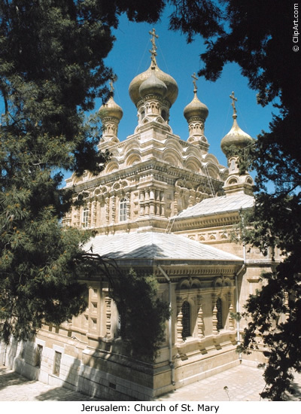
Cursed of God?
In the early years, the Christians looked upon the Temple Mount as a place that God had cursed. As Christianity gained foothold in the Roman world the Temple Mount was left to become a desolate rubble heap. In A.D. 534, over the site of Solomon's elaborate palace, the Emperor Justinian built mighty substructures as foundations for the New Church of St. Mary. While other holy sites in Jerusalem were explored and identified, the Temple Mount was neglected.

Slide 40
The Scourge of Anti-Semitism
One of the tragedies of this period was the anti-Semitism that arose among the "Christians." Concerning the Jews, early Christian leader John Chrysostom falsely wrote:
They sacrificed their sons and daughters to devils: they outraged nature and overthrew their foundations the laws of relationship. They are become worse than the wild beasts, and for no reason at all, with their own hands, they murder their offspring, to worship the avenging devils who are foes of our life...They know only one thing, to satisfy their gullets, get drunk, to kill and maim one another.
Chrysostom delivered eight sermons which expressed intense hatred of the Jews. His accusations were nothing but outright lies. The purpose of these falsehoods was to keep the Christians in Antioch from having any contact with the Jews. In another act of anti-Semitism, Bishop Ambrose of Milan ordered a synagogue to be set on fire. When Emperor Theodosius demanded an explanation the Bishop wrote him back:
I declare that I have set fire to the synagogue, or at least that those who did acted on my orders, so that there would be no place where Christ is rejected . . . Moreover, the synagogue was in fact destroyed by the judgment of God.
This desecration even angered the Romans. The bishop was required to rebuild the synagogue and those who had participated in its destruction were punished.
These, and others, failed to realize that it was God who had scattered the Jewish people and that He had ultimate purposes in doing so. The Jews would be a blessing to each city in which they were scattered to be regathered by God at the right time.

Slide 41
The Holocaust refers to the period from January 30, 1933, when Adolf Hitler became chancellor of Germany, to May 8, 1945 when the war in Europe ended.
During this time, Jews in Europe were subjected to progressively harsh persecution that ultimately led to the murder of 6,000,000 Jews (1.5 million of these being children) and the destruction of 5,000 Jewish communities. These deaths represented two-thirds of European Jewry and one-third of world Jewry.
The Jews who died were not casualties of the fighting that ravaged Europe during World War II. Rather, they were the victims of Germany's deliberate and systematic attempt to annihilate the entire Jewish population of Europe, a plan Hitler called the “Final Solution”.

Slide 42
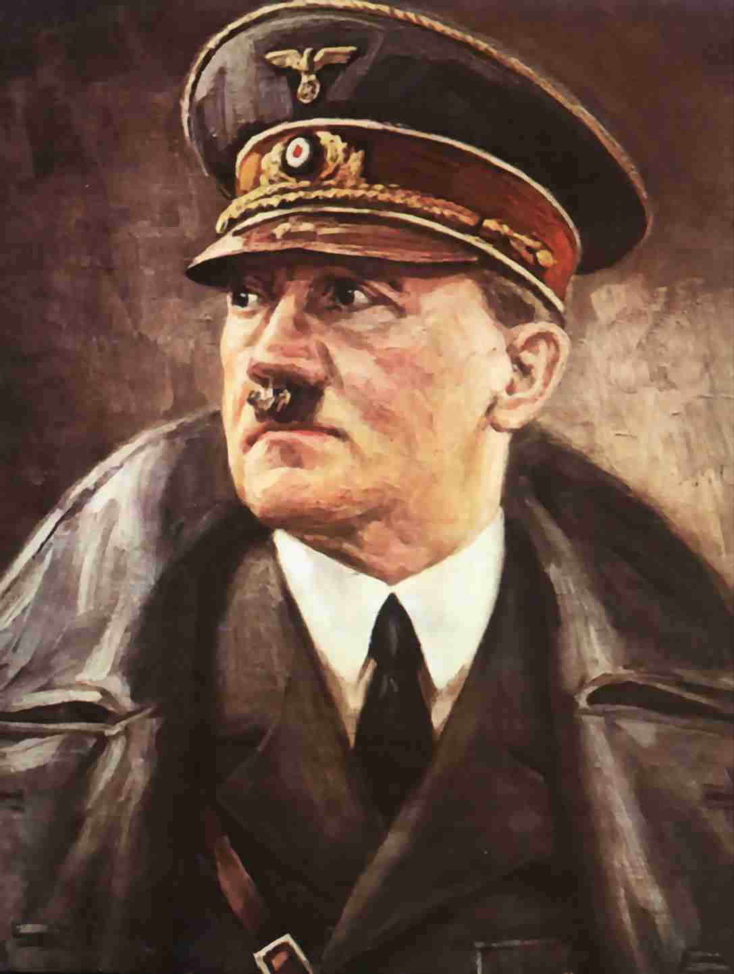
By the end of 1934 Hitler was in absolute control of Germany, and his campaign against the Jews in full swing. The Nazis claimed the Jews corrupted pure German culture with their "foreign" and "mongrel" influence. They portrayed the Jews as evil and cowardly, and Germans as hardworking, courageous, and honest. The Jews, the Nazis claimed, who were heavily represented in finance, commerce, the press, literature, theater, and the arts, had weakened Germany's economy and culture.
The massive government-supported propaganda machine created a racial anti-Semitism, which was different from the long­standing anti-Semitic tradition of the Christian churches.

Slide 43
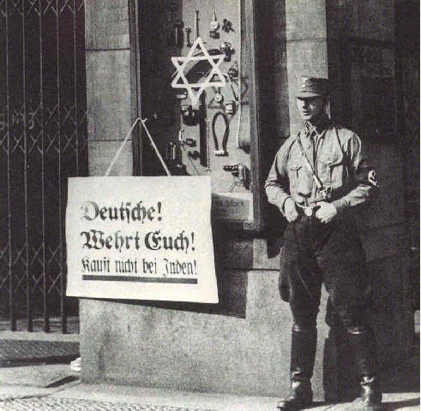
It began with a simple boycott of Jewish shops and ended in the gas chambers at Auschwitz as Adolf Hitler and his Nazi followers attempted to exterminate the entire Jewish population of Europe.

Slide 44
The resurrection of Israel -- The two sticks -- Promises to Israel.
The hand of the Lord was upon me, and carried me out in the Spirit of the Lord, and set me down in the midst of the valley which was full of bones,
And caused me to pass by them round about; and, behold, there were very many in the open valley; and, lo, they were very dry.
And he said unto me, Son of man, can these bones live? And I answered, O Lord God, thou knowest.
Again he said unto me, Prophesy upon these bones, and say unto them, O ye dry bones, hear the word of the Lord.
Thus saith the Lord God unto these bones; Behold, I will cause breath to enter into you, and ye shall live;
And I will lay sinews upon you, and will bring up flesh upon you, and cover you with skin, and put breath in you, and ye shall live; and ye shall know that I am the Lord. [Ezekiel 37:1-6]

Slide 45
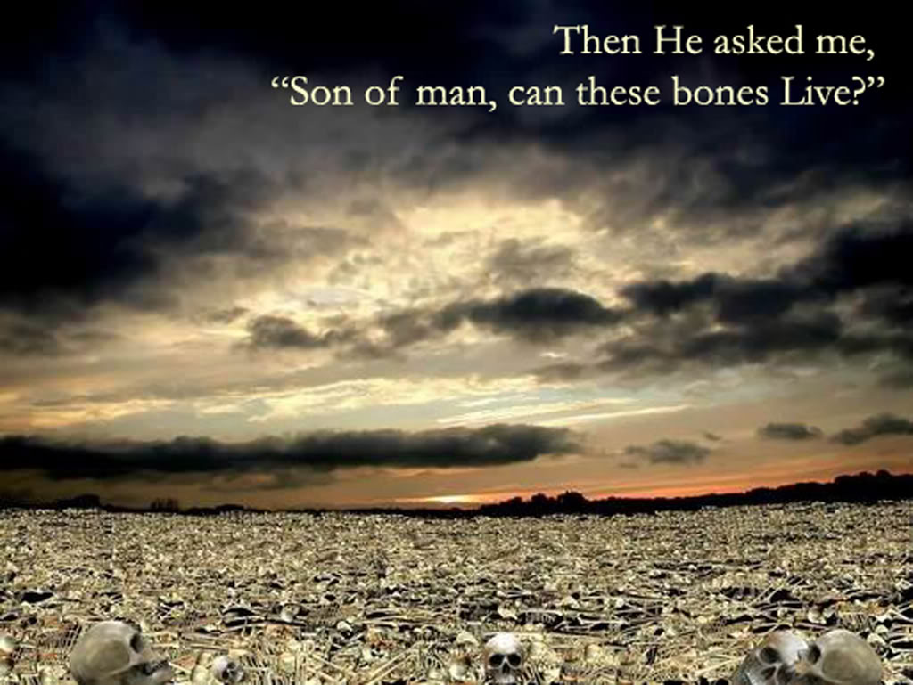

Slide 46
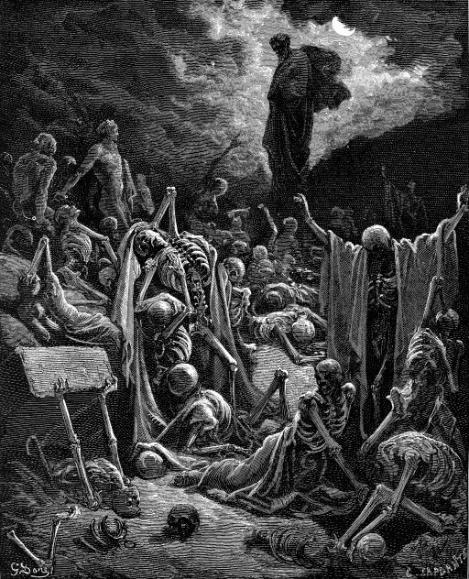
So I prophesied as I was commanded; and as I prophesied, there was a noise, and behold a shaking, and the bones came together, bone to his bone.
And when I beheld, lo, the sinews and the flesh came up upon them, and the skin covered them above, but there was no breath in them.
Then said he unto me, Prophesy unto the wind, prophesy, son of man, and say to the wind, Thus saith the Lord God; Come from the four winds, O breath, and breathe upon these slain, that they may live.
So I prophesied as he commanded me, and the breath came into them, and they lived, and stood up upon their feet, an exceeding great army.
[Ezekiel 37:7-10]

Slide 47
Then he said unto me, Son of man, these bones are the whole house of Israel; behold, they say, Our bones are dried, and our hope is lost; we are cut off for our parts.
Therefore prophesy and say unto them, Thus saith the Lord God; Behold, O my people, I will open your graves, and cause you to come up out of your graves, and bring you into the land of Israel.
And ye shall know that I am the Lord, when I have opened your graves, O my people, and brought you up out of your graves.
And shall put my Spirit in you, and ye shall live, and I shall place you in your own land; then shall ye know that I the Lord have spoken it, and performed it, saith the Lord.
[Ezekiel 37:11-14]

Slide 48
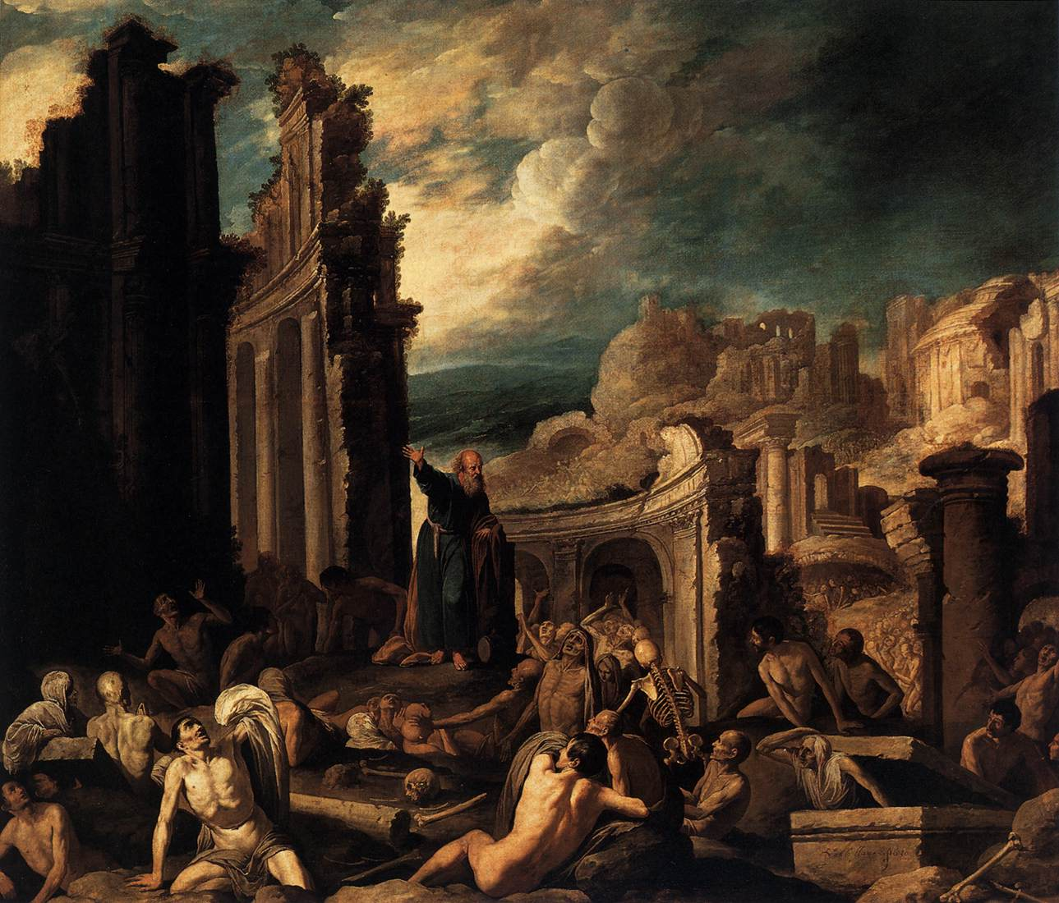

Slide 49
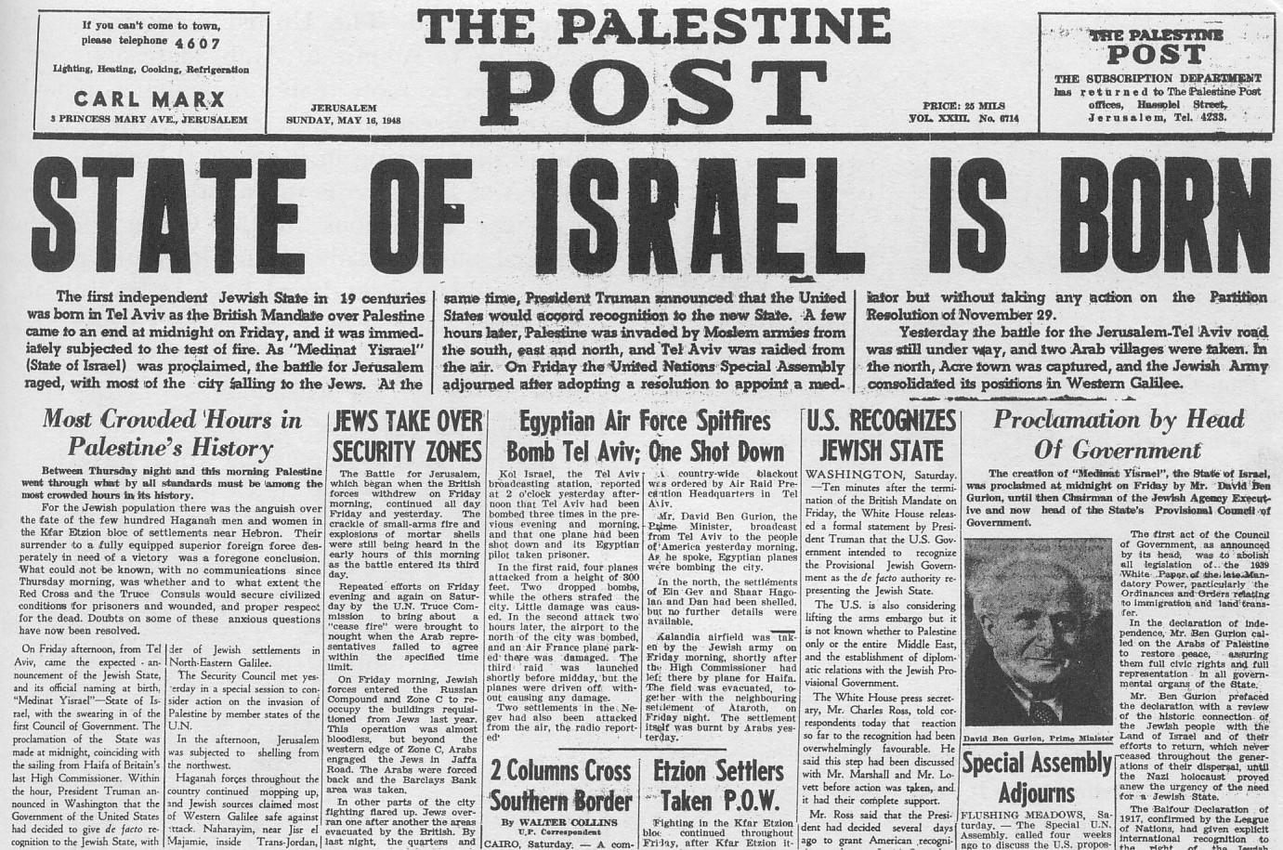
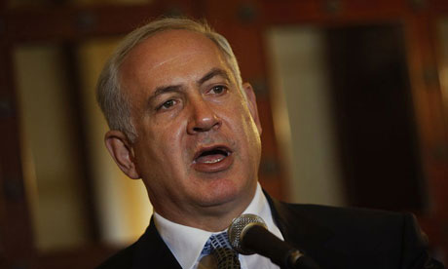
JERUSALEM, Israel - Speaking on the 65th anniversary of the liberation of the Nazi concentration camp at Auschwitz in Poland last week, Israeli Prime Minister Binyamin Netanyahu proclaimed the fulfillment of the prophet Ezekiel's vision of the valley of dry bones.
"The Jewish people rose from ashes and destruction, from a terrible pain that can never be healed," Netanyahu said at the ceremony.
"Armed with the Jewish spirit, the justice of man, and the vision of the prophets, we sprouted new branches and grew deep roots. Dry bones became covered with flesh, a spirit filled them, and they lived and stood on their own feet, as Ezekiel prophesized

Slide 51
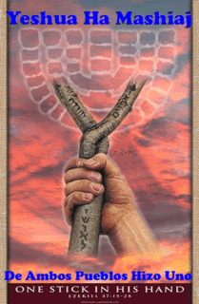
The word of the Lord came again unto me, saying,
Moreover, thou son of man, take thee one stick and write upon it, for Judah, and for the children of Israel his companions; then take another stick, and write upon it, for Joseph, the stick of Ephraim, and for all the house of Israel his companions;
And join them one to another into one stick; and they shall become one in thine hand.
And when the children of thy people shall speak unto thee, saying, Wilt thou not show us what thou meanest by these?
Say unto them, Thus saith the Lord God; Behold, I will take the stick of Joseph, which is in the hand of Ephraim, and the tribes of Israel his fellows, and will put them with him, even with the stick of Judah, and make them one stick, and they shall be one in mine hand.
And the sticks whereon thou writest shall be in thine hand before their eyes.
[Ezekiel 37:15-20]

Slide 52
And say unto them, Thus saith the Lord God; Behold, I will take the children of Israel from among the heathen, whither they be gone, and will gather them on every side, and bring them into their own land;
And I will make them one nation in the land upon the mountains of Israel; and one king shall be king to them all; and they shall be no more two nations, neither shall they be divided into two kingdoms anymore at all;
Neither shall they defile themselves anymore with their idols, nor with their detestable things, nor with any of their transgressions; but I will save them out of all their dwelling places, wherein they have sinned, and will cleanse them; so shall they be my people, and I will be their God.
And David my servant shall be king over them; and they all shall have one shepherd; they shall also walk in my judgments, and observe my statutes, and do them.
[Ezekiel 37:21-24]

Slide 53
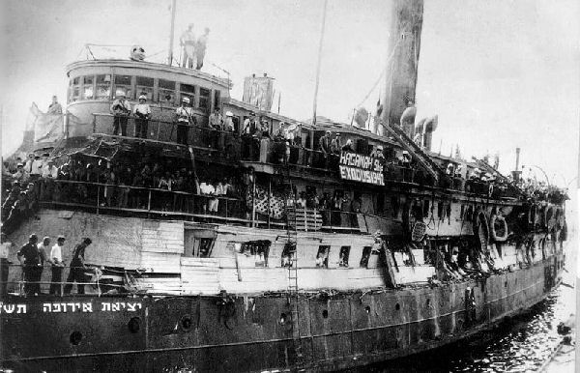
Eretz Israel
 | Exodus 1947
Exodus 1947 was a ship that carried Jewish emigrants, that left France on July 11, 1947, with the intent of taking its passengers to Palestine, then controlled by the British. Most of the emigrants were Holocaust survivor refugees, who had no legal immigration certificates to Palestine. Following wide media coverage, the British Royal Navy seized the ship, and deported all its passengers back to Europe.

Slide 54
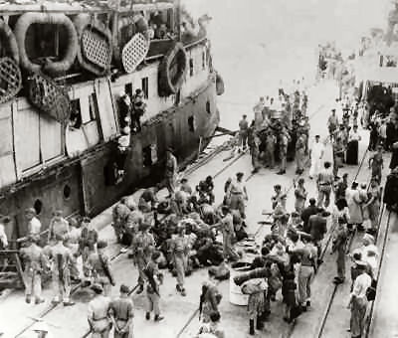
Purchased as war surplus in 1946, she was outfitted in Baltimore as part of a secret fleet to transport Holocaust survivors through the British blockade against Jewish immigration to the Land of Israel. On July 18, 1947, manned mainly by Americans and carrying over 4,500 refugees, she was attacked by British warships and boarded in international waters.
Three men were killed, including the American mate William Bernstein, dozens were wounded. During the struggle, the new ship's name, Exodus 1947, was proclaimed to the world. The British returned the captured refugees by force to detention camps in occupied Germany. The saga of Exodus 1947 inspired the world to condemn British policy, led to the UN resolution to partition Palestine, and symbolized the birth of Israel. The ship itself, battered and abandoned, burned and sank in Haifa harbor in 1952. Between 1946 and 1948 volunteers from the United States and Canada acquired, equipped and manned 10 ships which carried 30,000 refugees through the British blockade.”

Slide 55
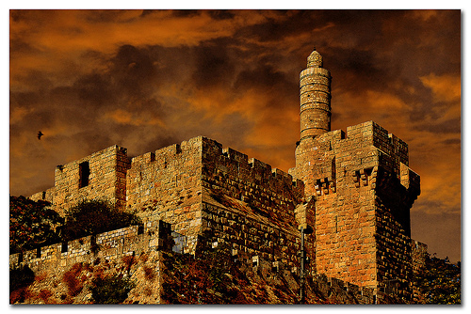
And they shall dwell in the land that I have given unto Jacob my servant, wherein your fathers have dwelt; and they shall dwell therein, even they, and their children, and their children's children forever; and my servant David shall be their prince forever.
Moreover I will make a covenant of peace with them; it shall be an everlasting covenant with them; and I will place them, and multiply them, and will set my sanctuary in the midst of them forevermore.
My tabernacle also shall be with them; yea, I will be their God, and they shall be my people.
And the heathen shall know that I the Lord do sanctify Israel, when my sanctuary shall be in the midst of them forevermore.
[Ezekiel 37:28]

