Slide 1
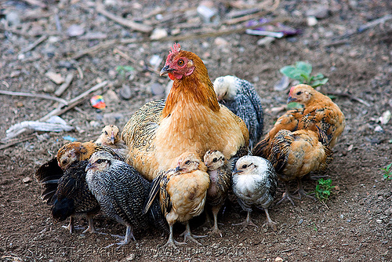
The Gathering
By Seventy James L. Noland

Slide 2

Woe to the land shadowing with wings, which is beyond the rivers of Ethiopia;…
Isaiah 18

Slide 3
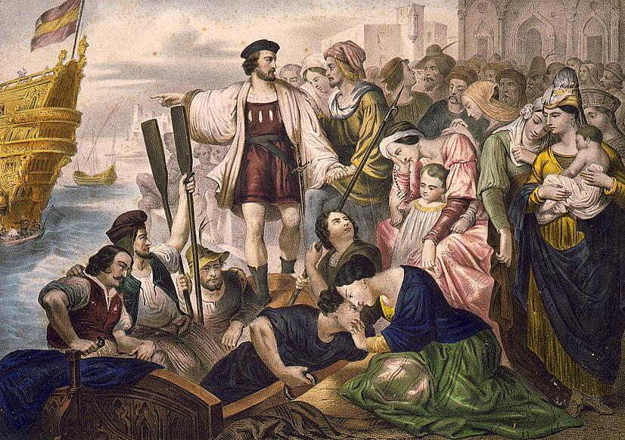
And I looked and beheld a man among the Gentiles, who was separated from the seed of my brethren by the many waters; and I beheld the Spirit of God, that it came down and wrought upon the man; and he went forth upon the many waters, even unto the seed of my brethren, who were in the promised land.
[1 Nephi 3:147]
Christopher Columbus
... our Lord opened to my understanding (I could sense his hand upon me), so that it became clear to me that it was feasible to navigate from here to the Indies; and he unlocked within me the determination to execute the idea.... Who doubts that this illumination was from the Holy Spirit? I attest that he [the Spirit], with marvelous rays of light, consoled me through the holy and sacred Scriptures.... encouraging me to proceed, and, continually, without ceasing for a moment, they inflame me with a sense of great urgency. (Kay Brigham – Christopher Columbus-His Life and discovery…1991:179)

Slide 4
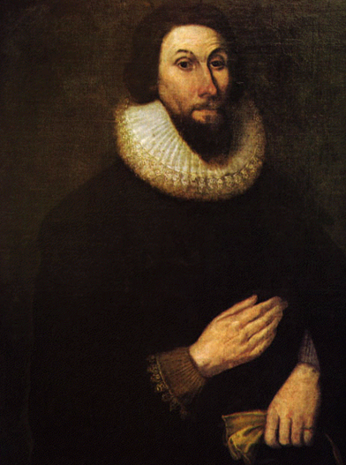
"The eyes of the world will be upon us. We are as a city upon a hill, raised up. You may think we're in the howling wilderness. You may think we're out beyond the farthest beyond. But in fact, God's providence is such that as the latter days begin to unfold, this may indeed be the city, the new Jerusalem that's unfolding before not only our eyes but the eyes of the world."
John Winthrop

Slide 5
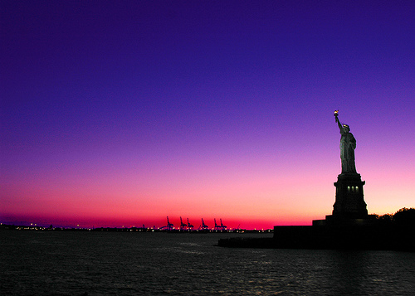
But behold, this land, saith God, shall be a land of thine inheritance; and the Gentiles shall be blessed upon the land.
And this land shall be a land of liberty unto the Gentiles: and there shall be no kings upon the land, who shall raise up unto the Gentiles.
And I will fortify this land against all other nations;
And he that fighteth against Zion, shall perish, saith God; for he that raiseth up a king against me, shall perish.
[2 Nephi 7:17-20]

Slide 6
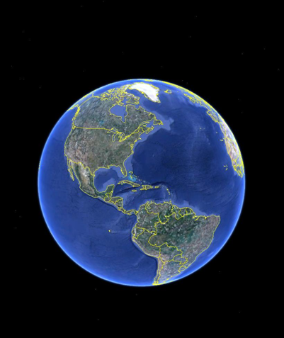
Wherefore the remnant of the house of Joseph shall be built up upon this land; and it shall be a land of their inheritance; and they shall build up a holy city unto the Lord, like unto the Jerusalem of old; and they shall no more be confounded, until the end come, when the earth shall pass away.
[Ether 6:8]

Slide 7

The Gathering

Slide 8
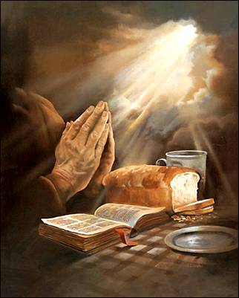
November 3, 1831
Wherefore prepare ye, prepare ye, O my people; sanctify yourselves; gather ye together, O ye people of my church, upon the land of Zion, all you that have not been commanded to tarry.
[Sec 108:2a]
Three months earlier - August 27, 1831
Behold, I, the Lord, will give unto my servant Joseph Smith, Jr., power that he shall be enabled to discern by the Spirit those who shall go up unto the land of Zion, and those of my disciples who shall tarry. [Sec 63:11]

Slide 9
Joseph Smith, Sidney Rigdon, and Oliver Cowdery arrived in Kirtland, August 27, 1831, from their first visit to the land of Zion. Joseph wrote in his history,
"In these infant days of the church, there was great anxiety to obtain the word of the Lord upon every subject that in any way concerned our salvation; and as the "land of Zion" was the most temporal object in view, I inquired of the Lord for further information upon the gathering of the Saints, and the purchase of the land and other matters."
It was in answer to this petition that Joseph Smith received the following revelation.

Slide 10
[Sec 63:8a] And now, behold, this is the will of the Lord your God concerning his Saints, that they should assemble themselves together unto the land of Zion, not in haste, lest there should be confusion, which bringeth pestilence.
August 27, 1831
[Sec 63:11] Behold, I, the Lord, will give unto my servant Joseph Smith, Jr., power that he shall be enabled to discern by the Spirit those who shall go up unto the land of Zion, and those of my disciples who shall tarry.
Sec 63:12c] Verily I say, Let him be ordained as an agent unto the disciples that shall tarry, and let him be ordained unto this power; and now speedily visit the churches, expounding these things unto them, with my servant Oliver Cowdery.

Slide 11
November 3, 1831
[Sec 108:2a] Wherefore prepare ye, prepare ye, O my people; sanctify yourselves; gather ye together, O ye people of my church, upon the land of Zion, all you that have not been commanded to tarry.
[Sec 108:3a] Send forth the elders of my church unto the nations which are afar off; unto the islands of the sea; send forth unto foreign lands; call upon all nations; firstly, upon the Gentiles, and then upon the Jews.
[Sec 108:3b] And, behold, and lo, this shall be their cry, and the voice of the Lord unto all people:
[Sec 108:3c] Go ye forth unto the land of Zion, that the borders of my people may be enlarged, and that her stakes may be strengthened, and that Zion may go forth unto the regions round about; yea, let the cry go forth among all people: Awake and arise and go forth to meet the Bridegroom.
[Sec 108:3d] Behold, and lo, the Bridegroom cometh, go ye out to meet him. Prepare yourselves for the great day of the Lord.
[Sec 108:4a] Watch, therefore, for ye know neither the day nor the hour. Let them, therefore, who are among the Gentiles, flee unto Zion.

Slide 12

And in the last days, before the Lord comes, he is to gather together his saints who have made a covenant with him by sacrifice. [Lecture 6:9c]
"Our God shall come, and shall not keep silence: a fire shall devour before him, and it shall be very tempestuous round about him. He shall call to the heavens from above, and to the earth, that he may judge his people. Gather my saints together unto me; those that have made a covenant unto me by sacrifice.“
Psalm 50:3-5
A fire shall devour before him!

Slide 13
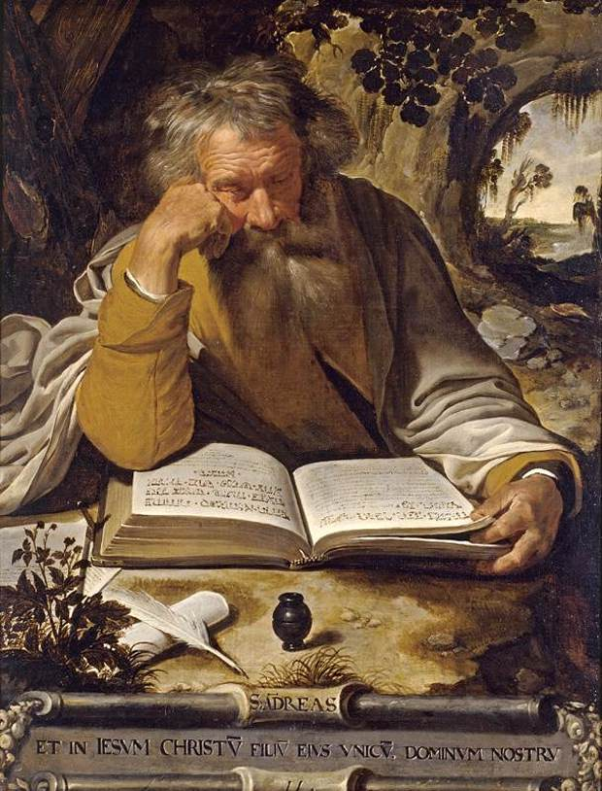
And righteousness and truth will I cause to sweep the earth as with a flood, to gather out mine own elect from the four quarters of the earth, unto a place which I shall prepare; an holy city, that my people may gird up their loins, and be looking forth for the time of my coming; for there shall be my tabernacle, and it shall be called Zion; a New Jerusalem.
[Genesis 7:70]

Slide 14
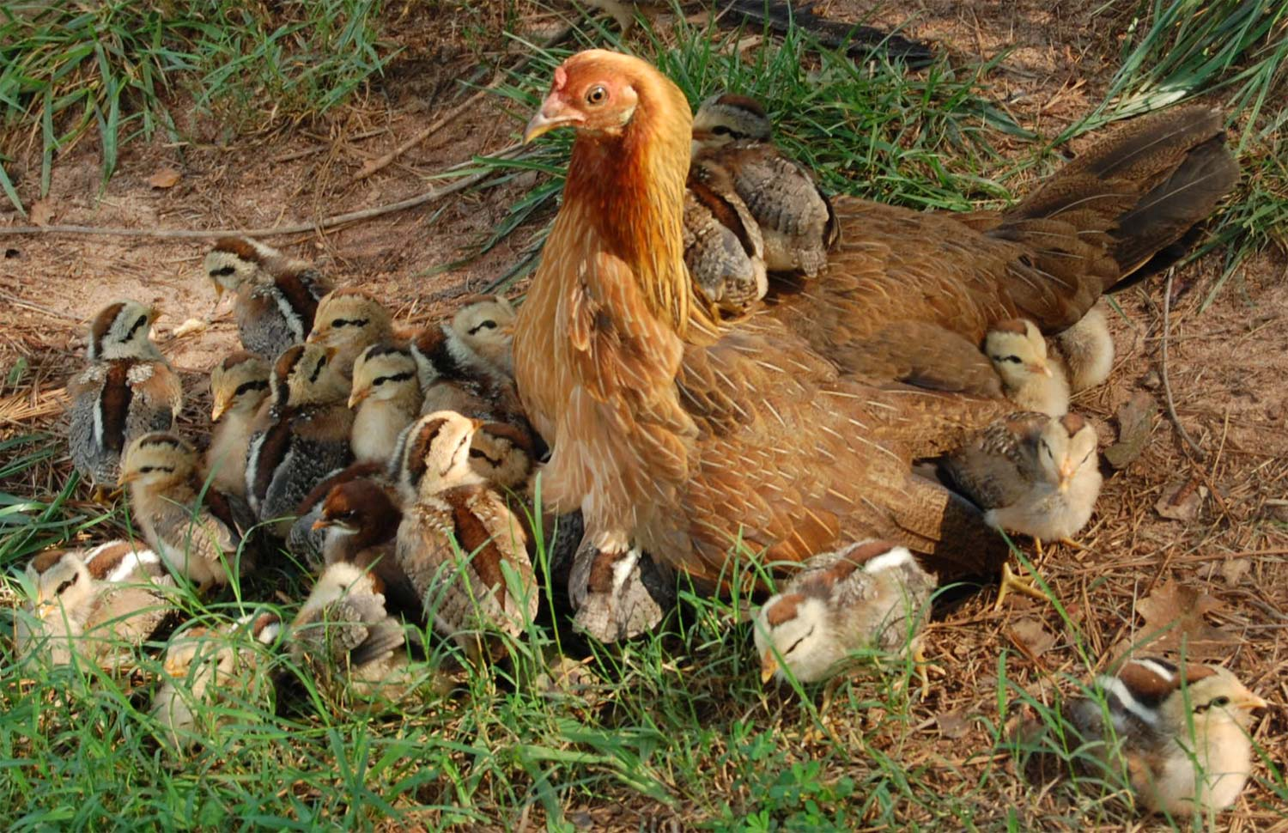
O Jerusalem! Jerusalem! Ye who will kill the prophets, and will stone them who are sent unto you; how often would I have gathered your children together, even as a hen gathers her chickens under her wings, and ye would not. [Matthew 23:37]

Slide 15
And it came to pass that there came a voice again unto the people, and all the people did hear, and did witness of it saying, O ye people of these great cities which have fallen, who are descendants of Jacob; yea, who are of the house of Israel, O, ye people of the house of Israel, how oft have I gathered you as a hen gathereth her chickens under her wings, and have nourished you.
And again, how oft would I have gathered you, as a hen gathereth her chickens under her wings; yea, O ye people of the house of Israel, who have fallen;
Yea, O ye people of the house of Israel; ye that dwell at Jerusalem, as ye that have fallen; yea, how oft would I have gathered you as a hen gathereth her chickens, and ye would not.
O ye house of Israel, whom I have spared, how oft will I gather you as a hen gathereth her chickens under her wings, if ye will repent and return unto me with full purpose of heart. But if not, O house of Israel, the places of your dwellings shall become desolate, until the time of the fulfilling of the covenant to your fathers.
[3 Nephi 4:55-59]

Slide 16
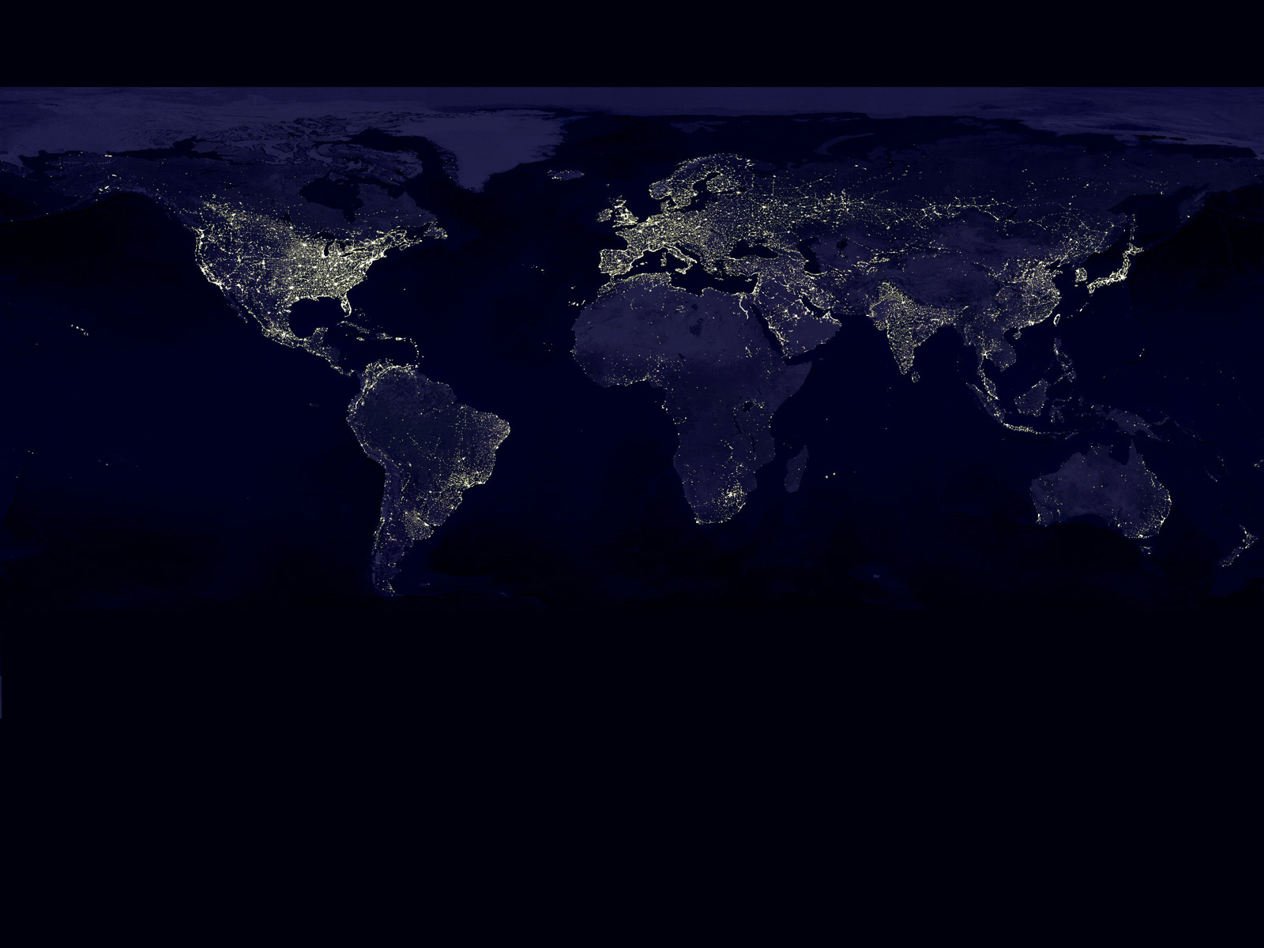
O, ye nations of the earth, how often would I have gathered you together as a hen gathereth her chickens under her wings, but ye would not?
[Sec 43:6b]

Slide 17
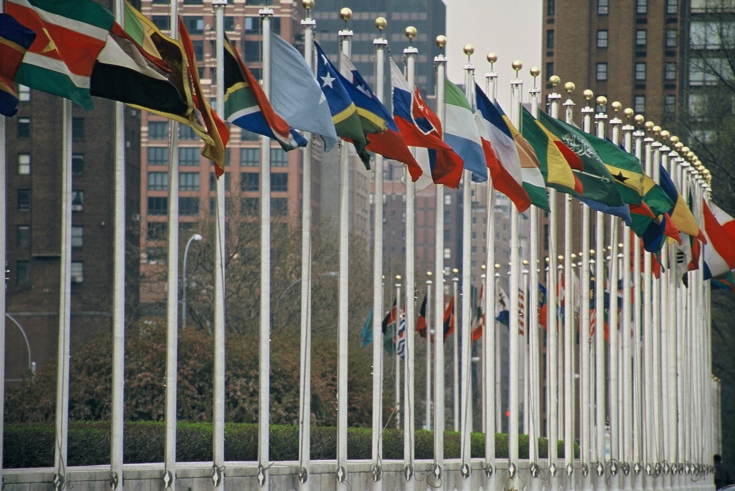
…that the kingdoms of this world may be constrained to acknowledge that the kingdom of Zion is in very deed the kingdom of our God and his Christ; therefore, let us become subject unto her laws. [Sec 102:9b]

Slide 18
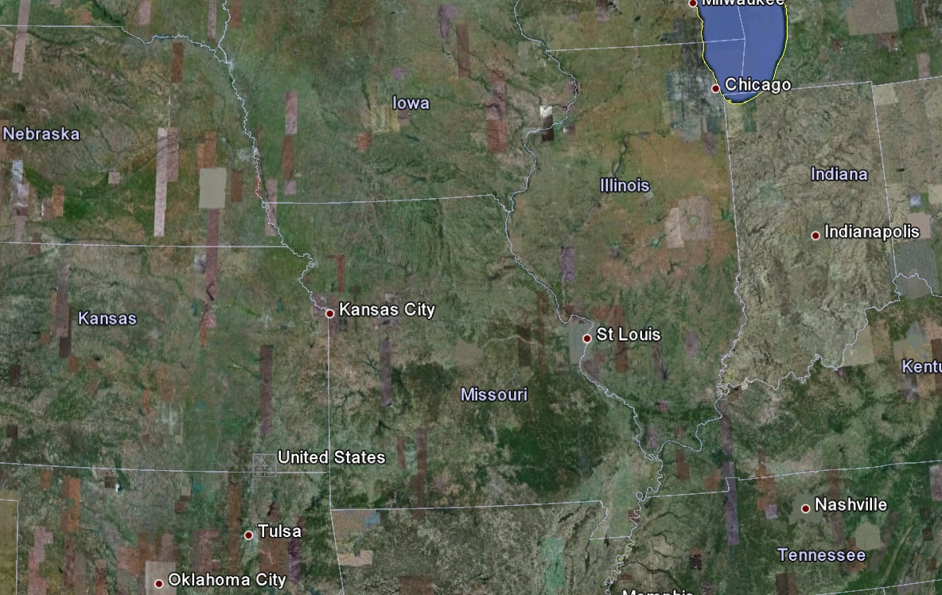
Hearken, O ye elders of my church saith the Lord your God, who have assembled yourselves together, according to my commandments, in this land which is the land of Missouri, which is the land which I have appointed and consecrated for the gathering of the Saints:
wherefore this is the land of promise, and the place for the city of Zion.
[Sec 57:1a-b]

Slide 19
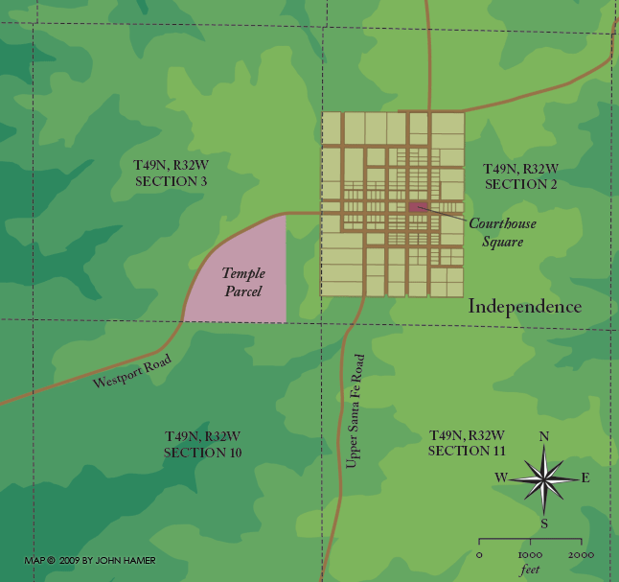
October 1830
Verily, this is the word of the Lord, that the city New Jerusalem shall be built by the gathering of the Saints, beginning at this place, even the place of the temple… [Sec 83:2a]

Slide 20
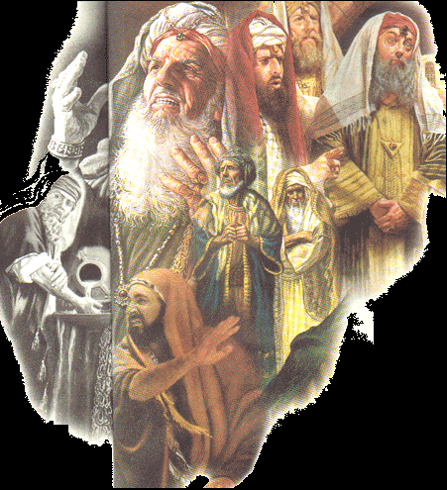
Lord, who shall abide in thy tabernacle? who shall dwell in thy holy hill of Zion?
He that walketh uprightly, and worketh righteousness, and speaketh the truth in his heart.
He that backbiteth not with his tongue, nor doeth evil to his neighbor, nor taketh up a reproach against his neighbor.
In whose eyes a vile person is condemned; but he honoreth them that fear the Lord; sweareth not falsely to hurt any man, and changeth not.
He that putteth not out his money to usury, nor taketh reward against the innocent. He that doeth these things shall never be moved. [Psalm 15:1-5]

Slide 21

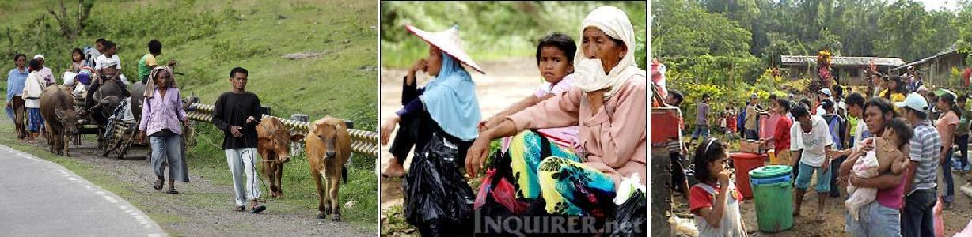
How is the Lord going to gather his people together?

Slide 22
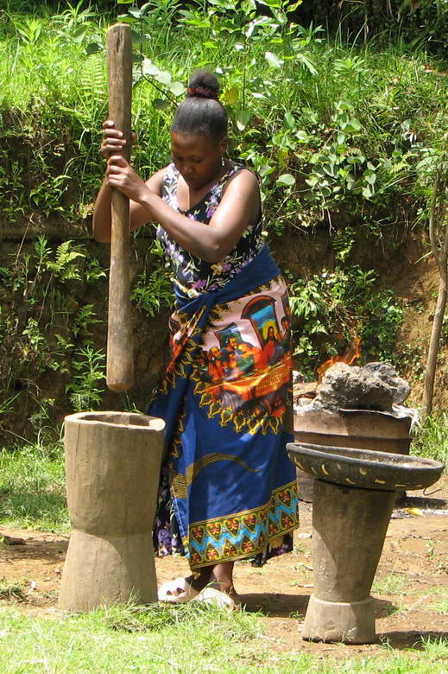
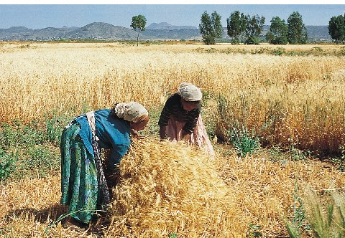
I tell you, in that night there shall be two in one bed; the one shall be taken, and the other shall be left. Two shall be grinding together; the one shall be taken, and the other left.
Two shall be in the field; the one shall be taken and the other left.
[Luke 17:34-35]

Slide 23
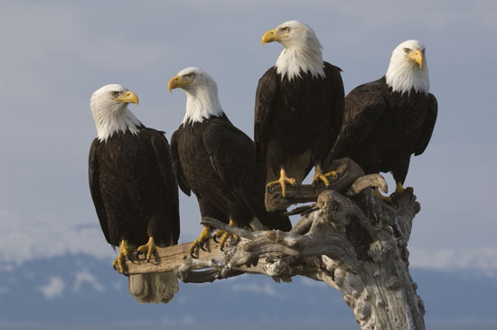
And they answered and said unto him, Where, Lord, shall they be taken.
And he said unto them, Wheresoever the body is gathered; or, in other words, whithersoever the saints are gathered, thither will the eagles be gathered together; or, thither will the remainder be gathered together.
This he spake, signifying the gathering of his saints; and of angels descending and gathering the remainder unto them; the one from the bed, the other from the grinding, and the other from the field, whithersoever he listeth.
For verily there shall be new heavens, and a new earth, wherein dwelleth righteousness.
And there shall be no unclean thing; for the earth becoming old, even as a garment, having waxed in corruption, wherefore it vanisheth away, and the footstool remaineth sanctified, cleansed from all sin.
[Luke 17:36-40]

Slide 24
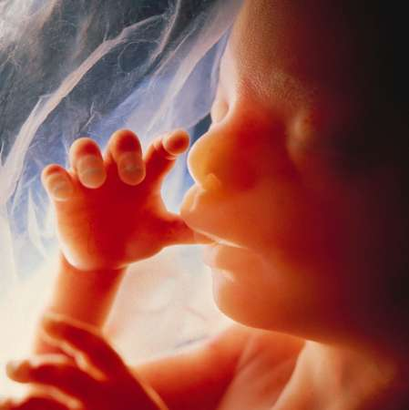
…ye are called to bring to pass the gathering of mine elect, for mine elect hear my voice and harden not their hearts;
wherefore the decree hath gone forth from the Father that they shall be gathered in unto one place, upon the face of this land, to prepare their hearts, and be prepared in all things, against the day when tribulation and desolation are sent forth upon the wicked;
[Sec 28:2c-2d]
August 1830
Lord, hear my voice!

Slide 25
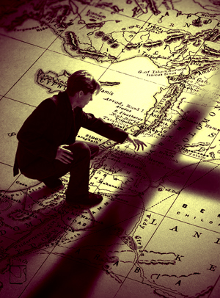
November 1831
Send forth the elders of my church unto the nations which are afar off; unto the islands of the sea; send forth unto foreign lands; call upon all nations; firstly, upon the Gentiles, and then upon the Jews.
And, behold, and lo, this shall be their cry, and the voice of the Lord unto all people:
Go ye forth unto the land of Zion, that the borders of my people may be enlarged, and that her stakes may be strengthened, and that Zion may go forth unto the regions round about; yea, let the cry go forth among all people: Awake and arise and go forth to meet the Bridegroom.
[Sec 108:3a-3c]

Slide 26
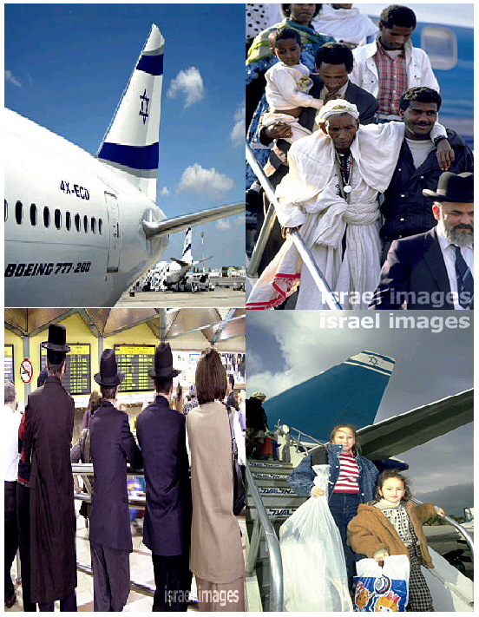
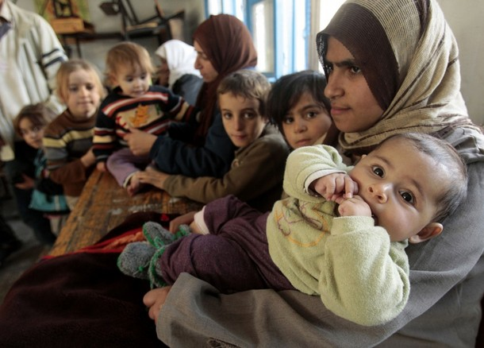
And also, as many of the house of Israel as shall come, that they may build a city, which shall be called the New Jerusalem;
  And then shall they assist my people that they may be gathered in, who are scattered upon all the face of the land, in unto the New Jerusalem.
And then shall the power of heaven come down among them; and I also will be in the midst, and then shall the work of the Father commence, at that day even when this gospel shall be preached among the remnant of this people.
[3 Nephi 10:2-4]

Slide 27
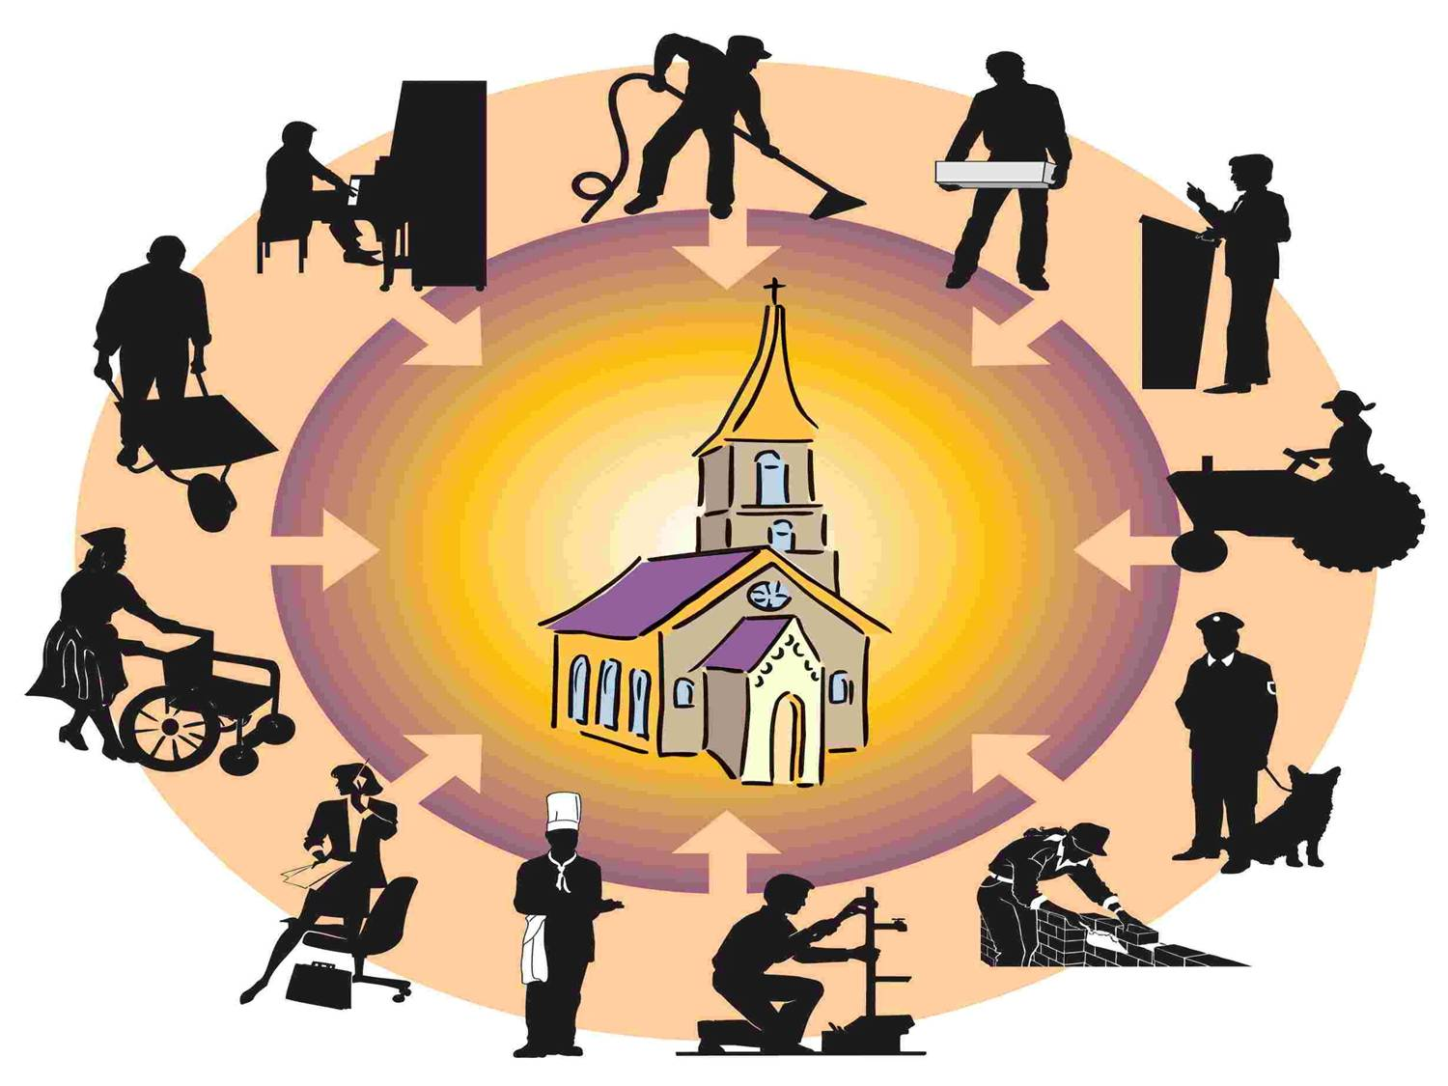
…and inasmuch as ye shall find them that will receive you, ye shall build up my church in every region, until the time shall come when it shall be revealed unto you from on high, when the city of the New Jerusalem shall be prepared, that ye may be gathered in one, that ye may be my people, and I will be your God. [Sec 42:3b]

Slide 28

yea, blessed are they whose feet stand upon the land of Zion, who have obeyed my gospel, for they shall receive for their reward the good things of the earth;
[Sec 59:1b]

Slide 29
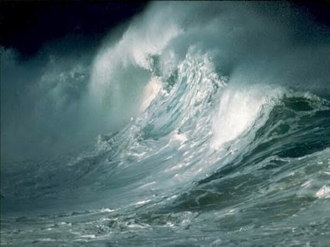
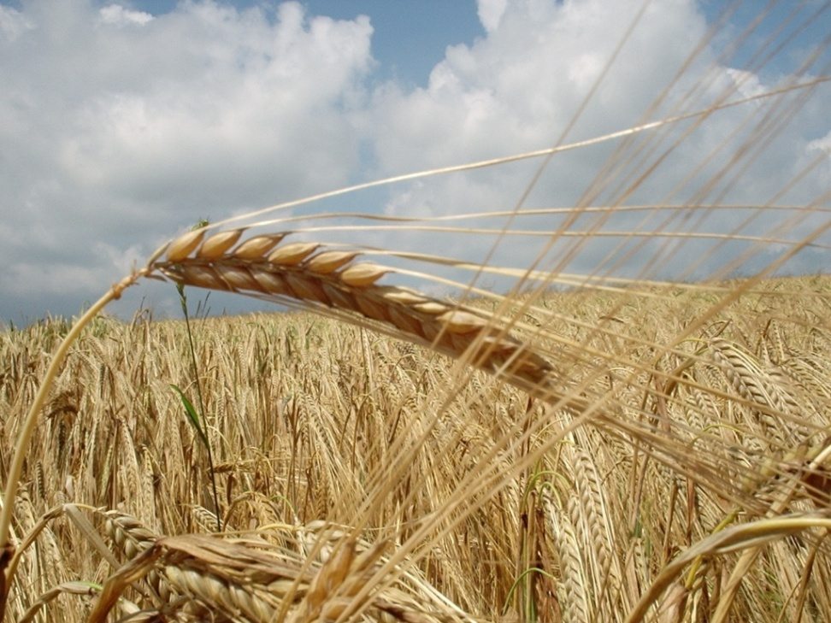
Wherefore, the days will come that no flesh shall be safe upon the waters, and it shall be said in days to come, that none is able to go up to the land of Zion, upon the waters, but he that is upright in heart.
And, as I, the Lord, in the beginning cursed the land, even so in the last days have I blessed it, in its time, for the use of my Saints, that they may partake the fatness thereof.
[Sec 61:3b-3c]

Slide 30
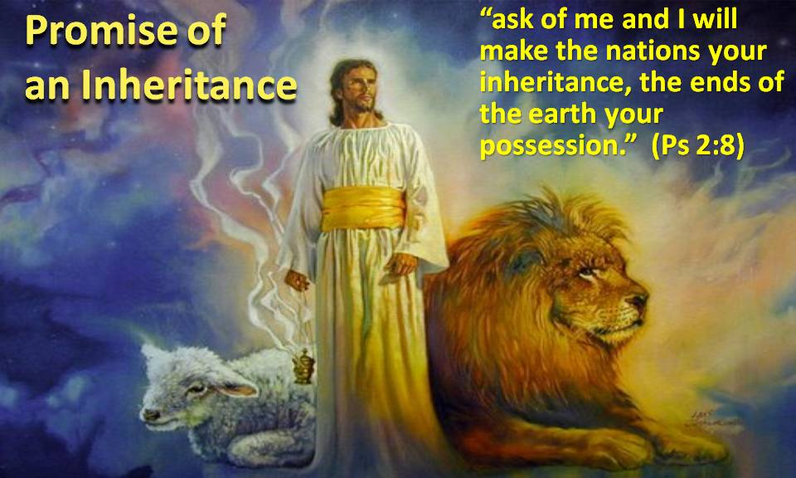
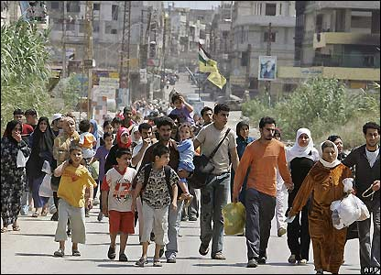
…and with one heart and with one mind, gather up your riches that ye may purchase an inheritance which shall hereafter be appointed unto you, and it shall be called the New Jerusalem, a land of peace, a city of refuge, a place of safety for the saints of the most high God;
and the glory of the Lord shall be there, and the terror of the Lord also shall be there, insomuch that the wicked will not come unto it; and it shall be called Zion.
And it shall come to pass, among the wicked, that every man that will not take his sword against his neighbor, must needs flee unto Zion for safety.
[Sec 45:12c-13a]

Slide 31
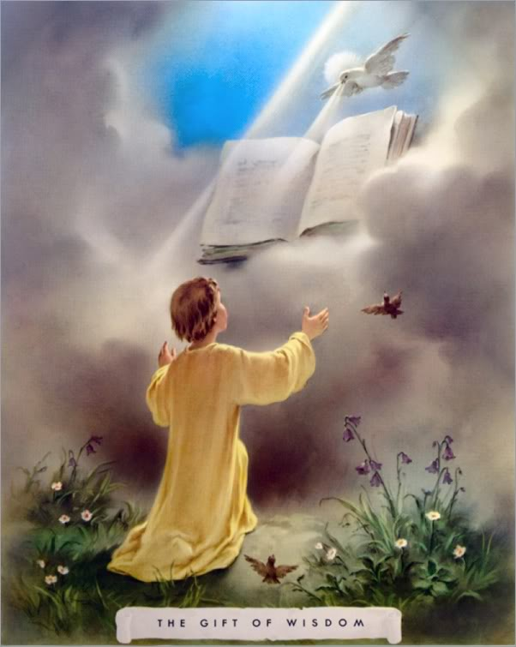
And blessed are they who shall seek to bring forth my Zion at that day, for they shall have the gift and the power of the Holy Ghost;
[1 Nephi 3:187]

Slide 32
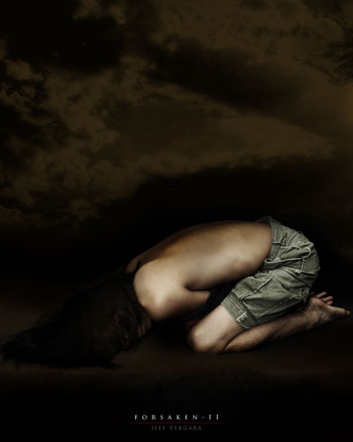
But behold, Zion hath said, The Lord hath forsaken me, and my Lord hath forgotten me; but he will shew that he hath not.
[1 Nephi 6:44]

Slide 33
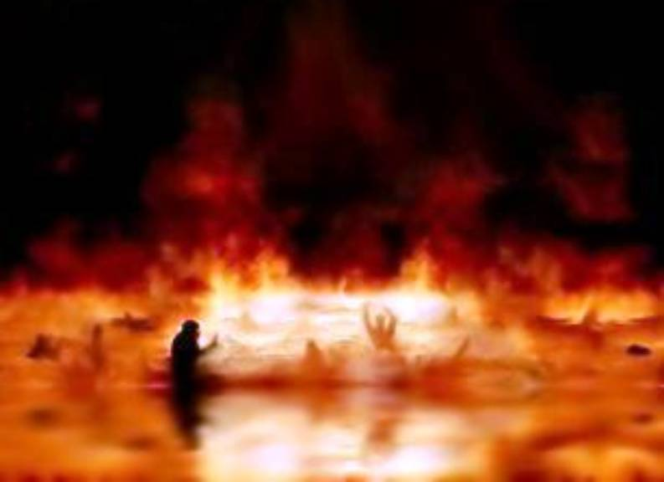
And all that fight against Zion, shall be destroyed.
[1 Nephi 7:30]

Slide 34
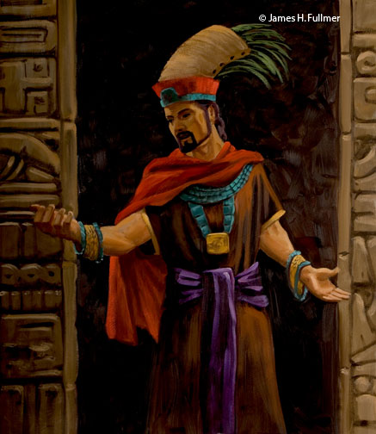
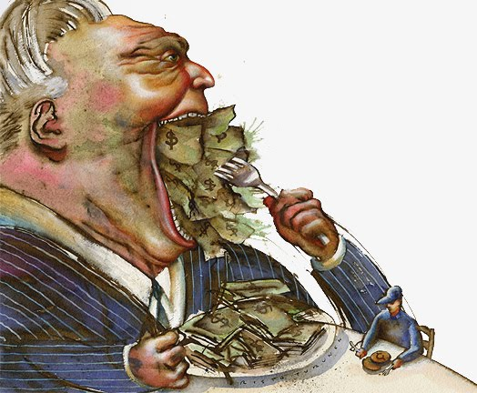
He commandeth that there shall be no priestcrafts; for, behold, priestcrafts are that men preach and set themselves up for a light unto the world, that they may get gain, and praise of the world; but they seek not the welfare of Zion.
[2 Nephi 11:106]

Slide 35







And others will he pacify, and lull them away into carnal security, that they will say, All is well in Zion; yea, Zion prospereth, all is well;
And thus the devil cheateth their souls, and leadeth them away carefully down to hell.
[2 Nephi 12:25-26]

Slide 36
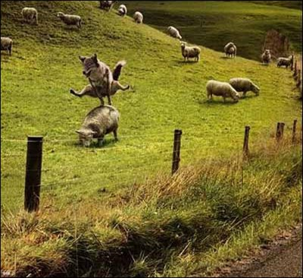
All is well in Zion

Slide 37
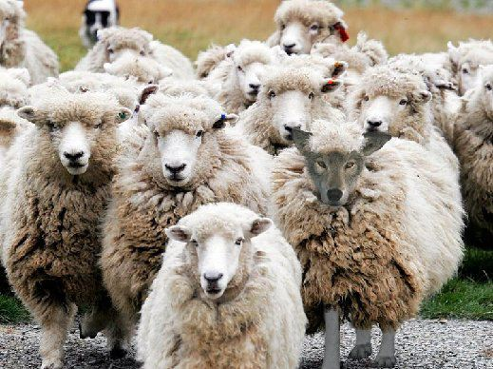
Zion prospereth, all is well!

Slide 38
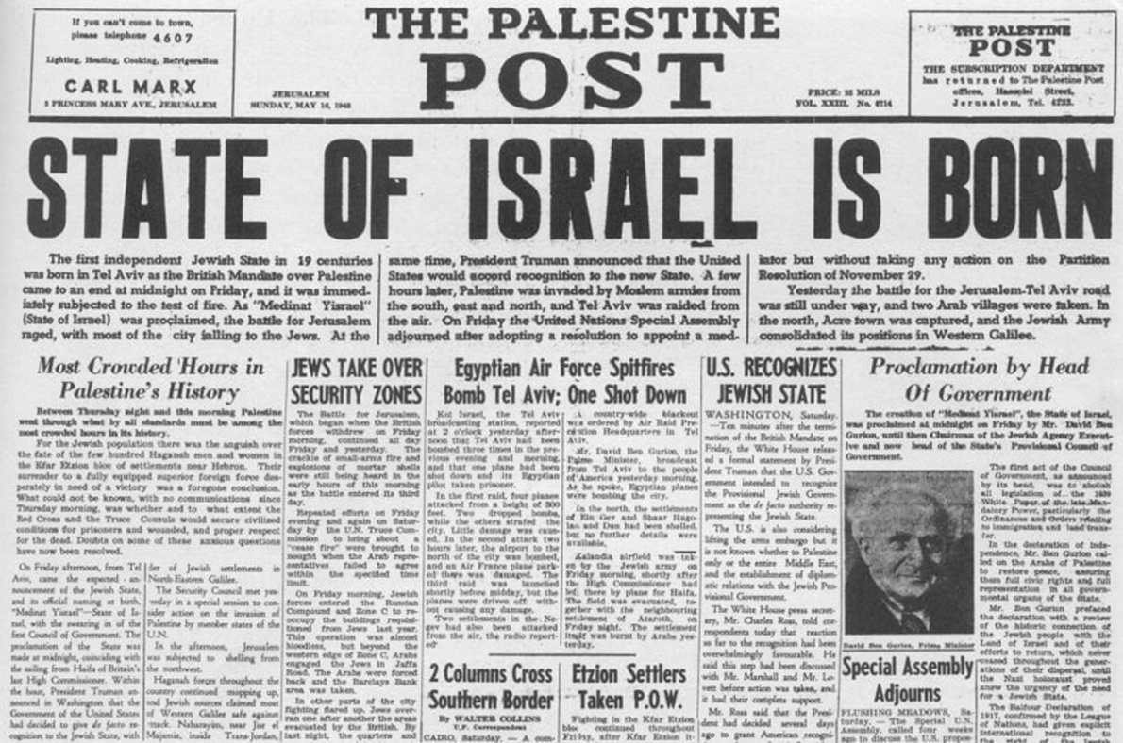
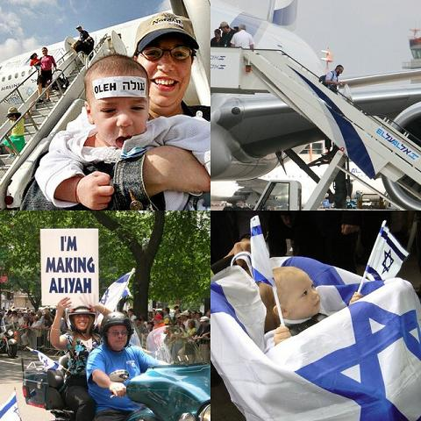
And verily, I say unto you, I give unto you a sign, that ye may know the time when these things shall be about to take place, that I shall gather in from their long dispersion, my people, O house of Israel, and shall establish again among them my Zion.
[3 Nephi 9:86]

Slide 39
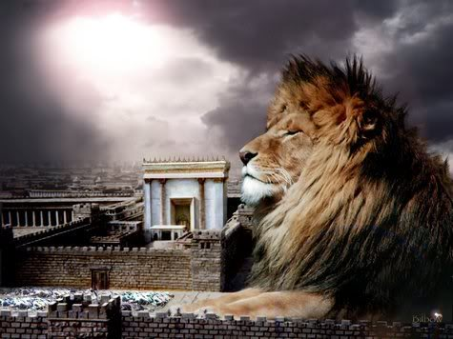


And awake, and arise from the dust, O Jerusalem; yea, and put on thy beautiful garments, O daughter of Zion, and strengthen thy stakes, and enlarge thy borders for ever, that thou mayest no more be confounded, that the covenants of the eternal Father which he hath made unto thee, O house of Israel, may be fulfilled.
[Moroni 10:28]

Slide 40

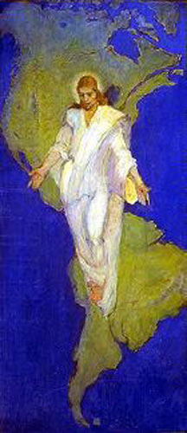
The Lord also shall roar out of Zion, and utter his voice from Jerusalem; and the heavens and the earth shall shake; but the Lord will be the hope of his people, and the strength of the children of Israel.
[Joel 3:16]

Slide 41
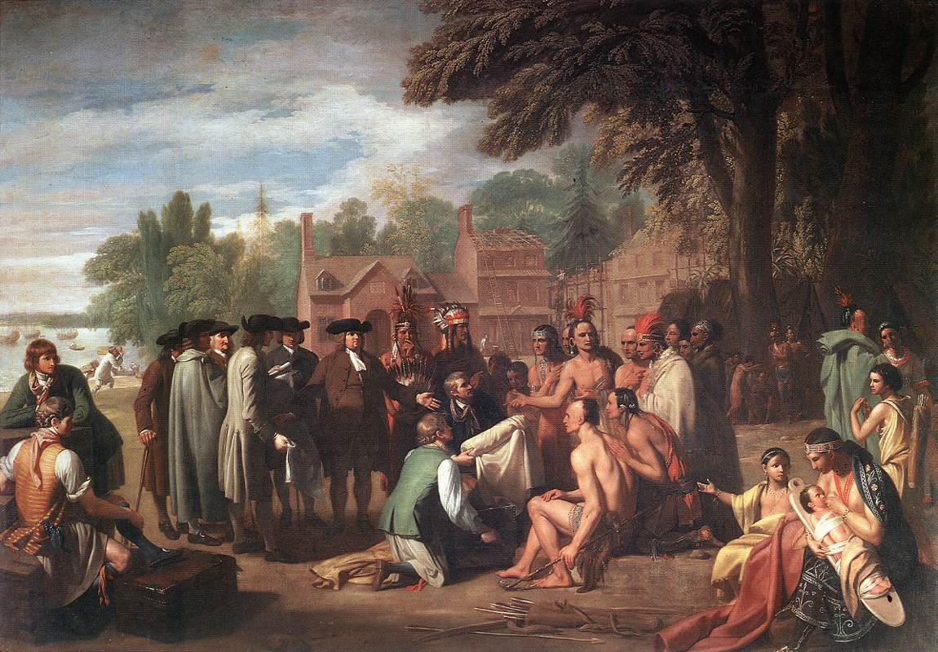

Slide 42
Why gather and what are the benefits?
It is a commandment of the Lord.
The Gentiles shall be blessed upon the land.
This land shall be a land of liberty unto the Gentiles.
The Lord will fortify this land against all other nations.
The Saints shall no more be confounded.
To prepare their hearts, and be prepared in all things, against the day when tribulation and desolation comes on the earth.
The power of heaven will come down among them; and the Lord also will be in there midst.
They shall receive for their reward the good things of the earth.

Slide 43
Why gather and what are the benefits?
9. The only people that will be at peace, in a city of refuge, a place of safety for the saints
10. The glory of the Lord shall be there, and the terror of the Lord also shall be there, insomuch that the wicked will not come unto it.
11. Every man that will not take his sword against his neighbor, must needs flee unto Zion for safety.
12. They shall have the gift and the power of the Holy Ghost.
13. The covenants of the eternal Father which he hath made unto thee, O house of Israel, may be fulfilled.
14. That the Lord will be the hope of his people, and the strength of the children of Israel.

Slide 44
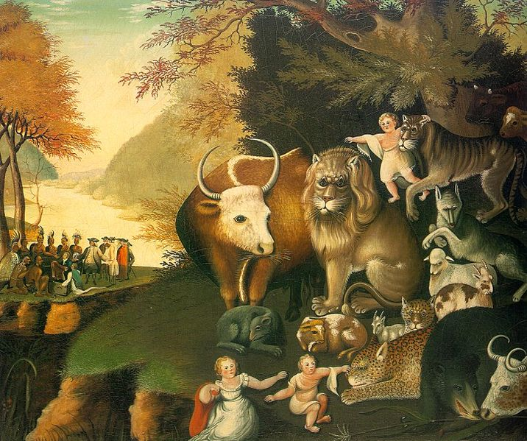

Slide 45
The Gathering
By Seventy James L. Noland 2010
Home 816-373-8684 / Cell 816-739-1443 James@ChristianSoup.com

